Slide 1
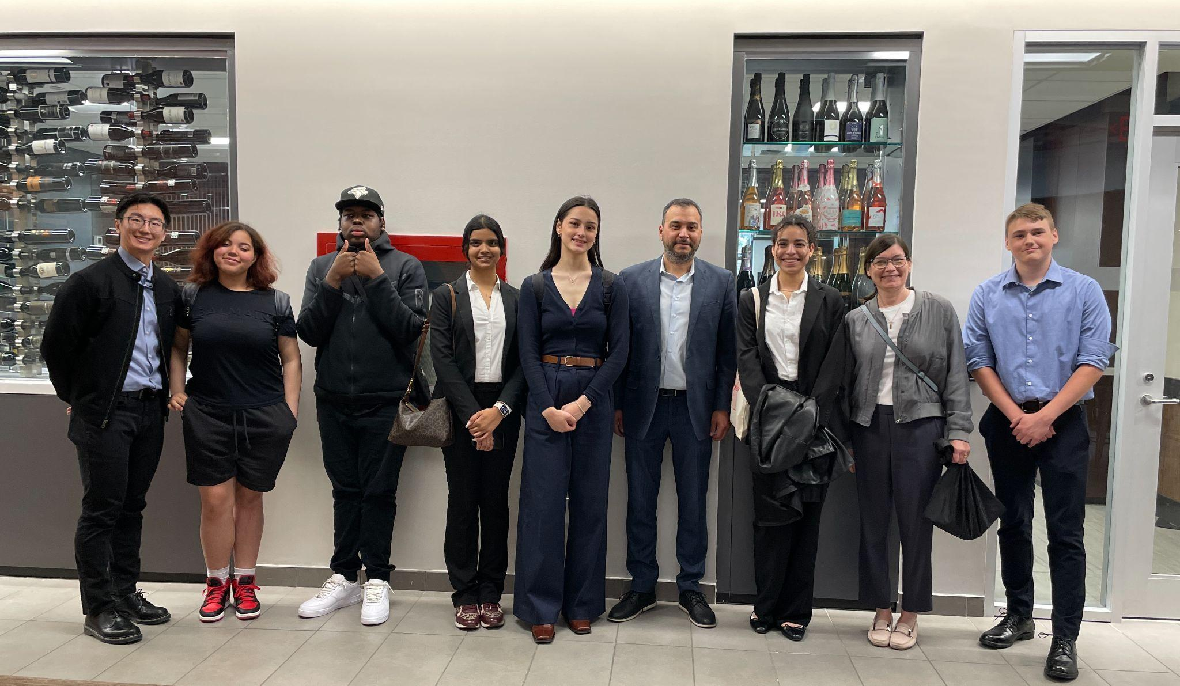
Cooperative Education & Be Our Guest
How to engage youth in hospitality

Slide 2
How to Ignite Interest in Hospitality
Be Our Guest Program
Cooperative Education (Co-op)
Other ways to engage youth
Field trips
Speakers
Certifications

Slide 3
TDSB - Be Our Guest Co-op Program
Cooperative Education program in hospitality
Hotels
Restaurants
Event Centres
And more
Matches students to hotel needs
Support property staff, students, and home-school teachers
Organizes field trips and other connections to learning

Slide 4
Co-op Basics
TERMS
Placement: is the business/property hosting the student
Supervisor: is the staff person mentoring the student
Monitoring: the co-op teacher visits the placement and speaks to the supervisor about the student’s progress
Performance Appraisal: a brief appraisal of the student’s progress

Slide 5
Co-op: What is it?
Co-op is a high school course in which students:
go to a workplace
learn and experience the industry
gain skills
have real workplace responsibilities
develop professionalism
earn credits
usually in grades 11 or 12
are assessed by the co-op supervisor and the co-op teacher
Notes:
Co-op is a high school course like math or english only it’s way more fun because the student doesn’t even go to school - they go to a workplace
Students choose the field they’re interested in they have a vested interest in co-op and learning. In fact, students interested in a business placement are perfect for working in hotels and learn how exciting it can be. Placements for business students include: sales, reservations, marketing, finance, HR, front desk, etc
Keep in mind that for many students this will be their first time in a professional working environment so having access to as many opportunities as possible will really help the student
And when it comes to assessment -remember students are young and cannot be assessed the same way as an employee - need continual productive feedback and encouragement because they may not know things that you think are obvious

Slide 6
Co-op Basics
The Co-op Term & Schedule
The term is based on the school calendar
Semester 1 Sept to Jan
Semester 2 is Feb to June
Students are in school for the first 2 or 3 weeks
15 weeks (4 months)
Summer school is 4 or 6 weeks starting in July
Notes:
The co-op term must follow the school year calendar, daily schedule and the exact times the teachers lays out but they’re a bit flexible and you can work out the details with the co-op teacher.
Because students must start on a specific date determined by the school and teacher, interviews and onboarding must happen in a timely manner – ideally at least 2 weeks before the start date.

Slide 7
Co-op Basics
The Daily Schedule
Half day students
AM 8:30 to 11:30
PM 1:00 to 4:00
Full day students
9:00 to 3:00
Monday to Friday during school hours (generally)
Notes:
Daily co-op shifts must also adhere to the school day timetable so that the co-op teacher is available to monitor and to support both students and staff.

Slide 8
Co-op Basics
Co-op is usually unpaid
Students earn credits not money
Complete course provided by the co-op teacher
Teacher visits the property and support the supervisor
Assessments are done to provide feedback to students
WSIB is covered by the Ministry of Education

Slide 9
Planning Co-op
When to plan
In May or June for the upcoming school year
In Nov or Dec for the upcoming semester
Communicate with your staff
Let co-op teachers know about the placements
Departments
Number of students
Schedule: AM/PM/Full-Day
Job Descriptions
Notes:
Note: students pick their courses the year before. Students know if they will have co-op on their timetable in the spring before the year begins.

Slide 10
How to Start a Co-op Program
Start with your team:
How to find supervisors on your team
Survey the staff
Leadership opportunity for those wanting more responsibility
Develop a plan
Start by taking 1-2 students

Slide 11
Example of a Strong Program
Provide a rotations to two different areas in the hotel
Front Desk & HR
Spa & Housekeeping
Reservations & Sales
Provide an orientation
Provide enrichment opportunities
Staff are invested in their success

Slide 12
How to Start a Co-op Program
Once you have determined who will supervise:
Connect with the local school
Call and ask for the co-op teacher
Drop by and introduce yourself
Invite the teacher to the property
Plan way ahead of the start of the semester
Work with t he co-op teacher
Interview the student candidates
Notes:
The co-op teacher at each school is the person who knows the students and can recommend students for your property.
Please interview the student candidates before making a decision to offer a placement.

Slide 13
High school co-op vs. a post-secondary practicum?
Focus is on career exploration
Placements provide a general overview of the industry
Students create a Learning Plan that allows them to set goals
Helps students with post secondary planning
Teacher monitors and supports the student and you

Slide 14
Specialist High Skills Major - SHSM
Hospitality & Tourism
Components of the Program
Students specialize in hospitality & tourism
Take related courses at school like Culinary Art, Tourism, etc.
Visit related properties like resorts, hotels, and restaurants
Earn certifications
Food Handlers Certificate
OTEC’s Service Excellence
Participate in co-op
Notes:
Ministry of Education has the SHSM program with a focus on a particular economic sector
complete a specific bundle of 8-10 courses in the student's selected field
earn industry certifications like first aid and CPR qualifications
gain important skills on the job through cooperative education placements
Hospitality and Tourism - take 4 field related courses and 3 others plus additional certifications ex: event coordination or food handler, project management etc… and the SHSM is for any pathway

Slide 15
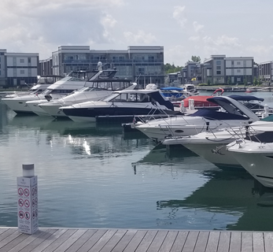
Part 2: Career Development
Providing field trips
What makes an effective field trip ex: Friday Harbour
Full-day
Tour
Speaker rotation (several departments)
Lunch
Activity
Notes:
Field trips make lasting impressions on students because they are out of hte classroom and making connections with the real world and industry. The purpose is for students to have a fuller understanding of the industry, related careers and the working environment.

Slide 16
Career Development
Be a Guest Speaker in a Class - Gr.10 Careers, Business Studies
Students want to hear from people in the community
Discuss pathway, education, experience, struggles, successes
What is a day like
Other career information
Become invested in community

Slide 17
Other Considerations and Goals
Students may not have any work experience, or very little when they enter co-op. Goals should focus on:
Skill development in a supportive setting
Mentorship in developing goals, skills, and credentials for next steps
Supervisor and colleague patience and understanding as students move through their career exploration
Placement prioritizing opportunities for student growth
Often the growth and learning is reciprocal
Notes:
Students can take awhile to warm up. It takes a few weeks before you start to really see the promise in their abilities (they can be shy, hold back, not say much, feel insecure at the beginning)
Sometimes taking 2 students at the same time can actually be easier for you because the students will feel more relaxed with a peer

Slide 18
Things you may not have thought of and Questions
Students love responsibility
They enjoy being part of the work world
They like being busy and having real, complex work
Don’t be afraid to challenge them!

Slide 19
Thank you for listening!

